Slide 1
HMF Series: 3-Speed Motor
Staffa Training
February 2017

Slide 2
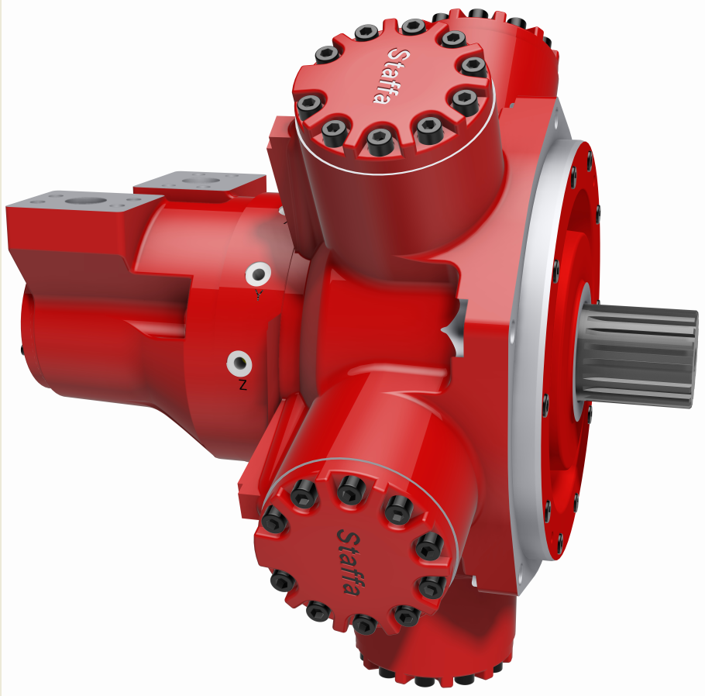
Agenda
HMF Series
  Description
  Market position
  Design
  R&D Testing
  Performance
  Special Features
  Installation
  Model Code

Slide 3
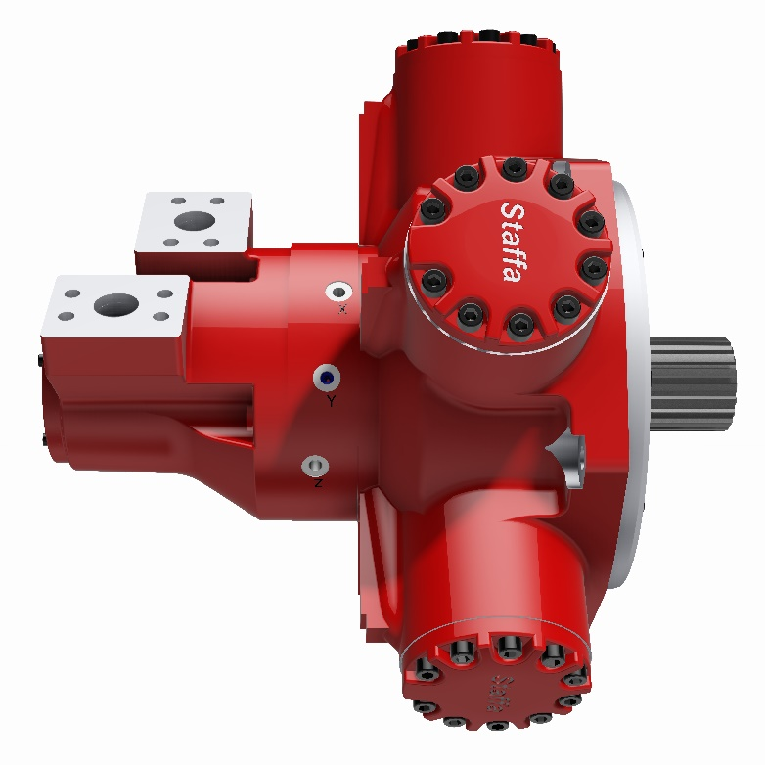
Description
3 displacement modes
Pilot operated
Four frame sizes:
  HMF100
  HMF200
  HMF270
  HMF325
Freewheel option available on all sizes
Based on HMC motor range – same performance and reliability expected from Staffa products
Many special features available
Notes:
No HMF125…

Slide 4
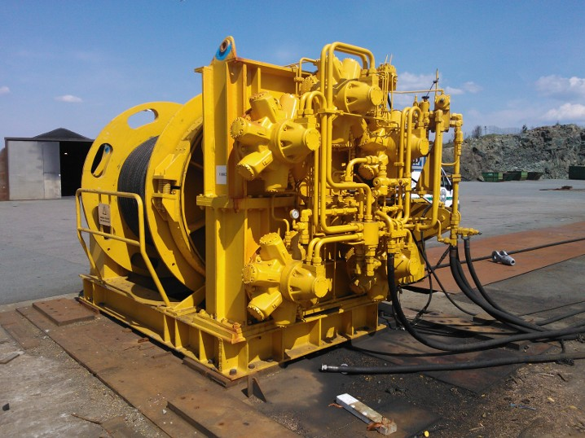
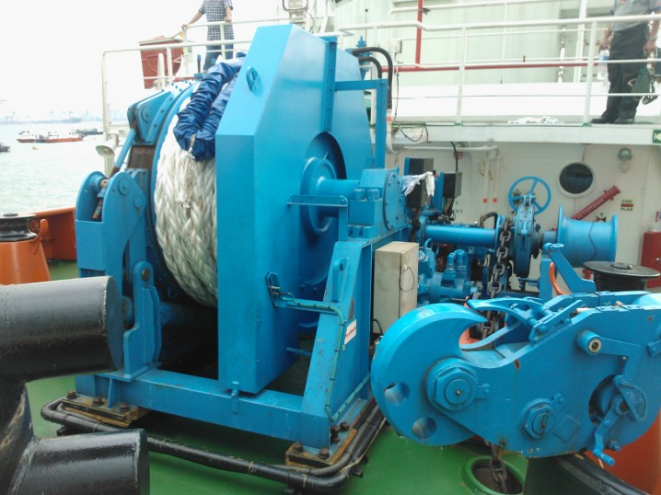
Market Position
Marine winches:
  Three displacement modes for greater flexibility
  Reduction of system complexity – fewer motors for same or greater functionality
  Two speed modes plus high-speed freewheel mode in one motor
  Cost-effective solution due to mechanical operation

Slide 5
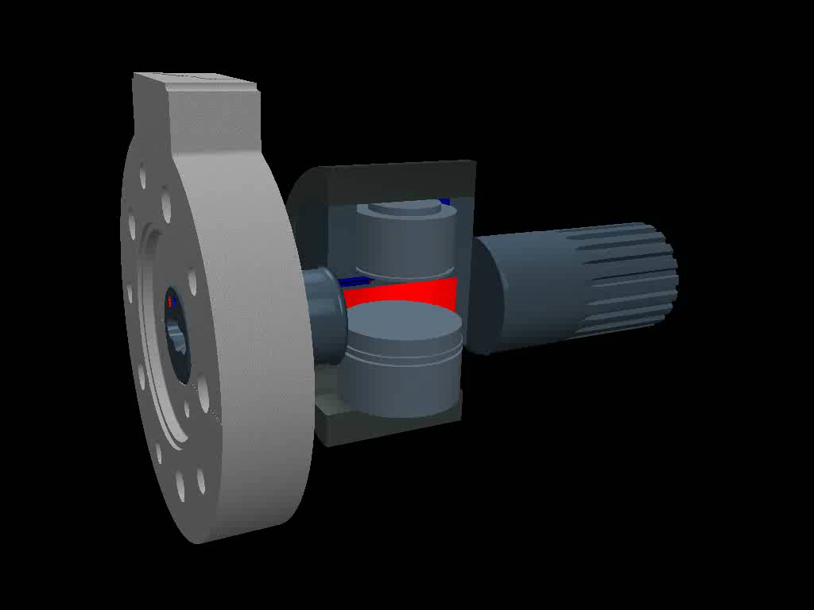
Design: HMC Displacement Change

Slide 6
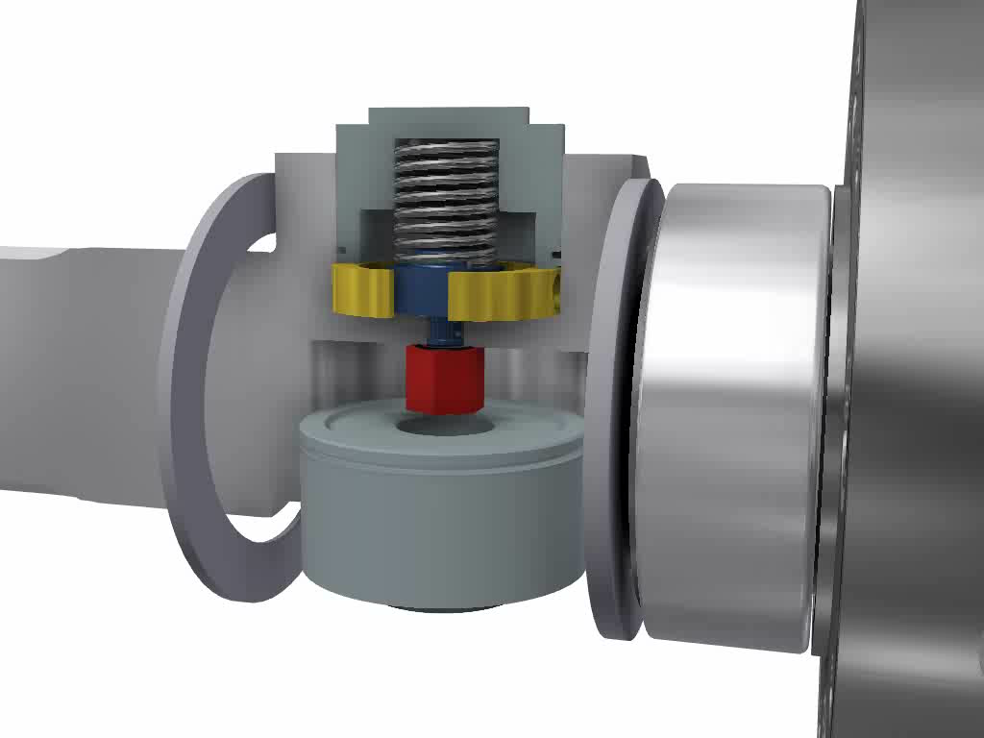
Design: Mechanical Stop Mechanism

Slide 7
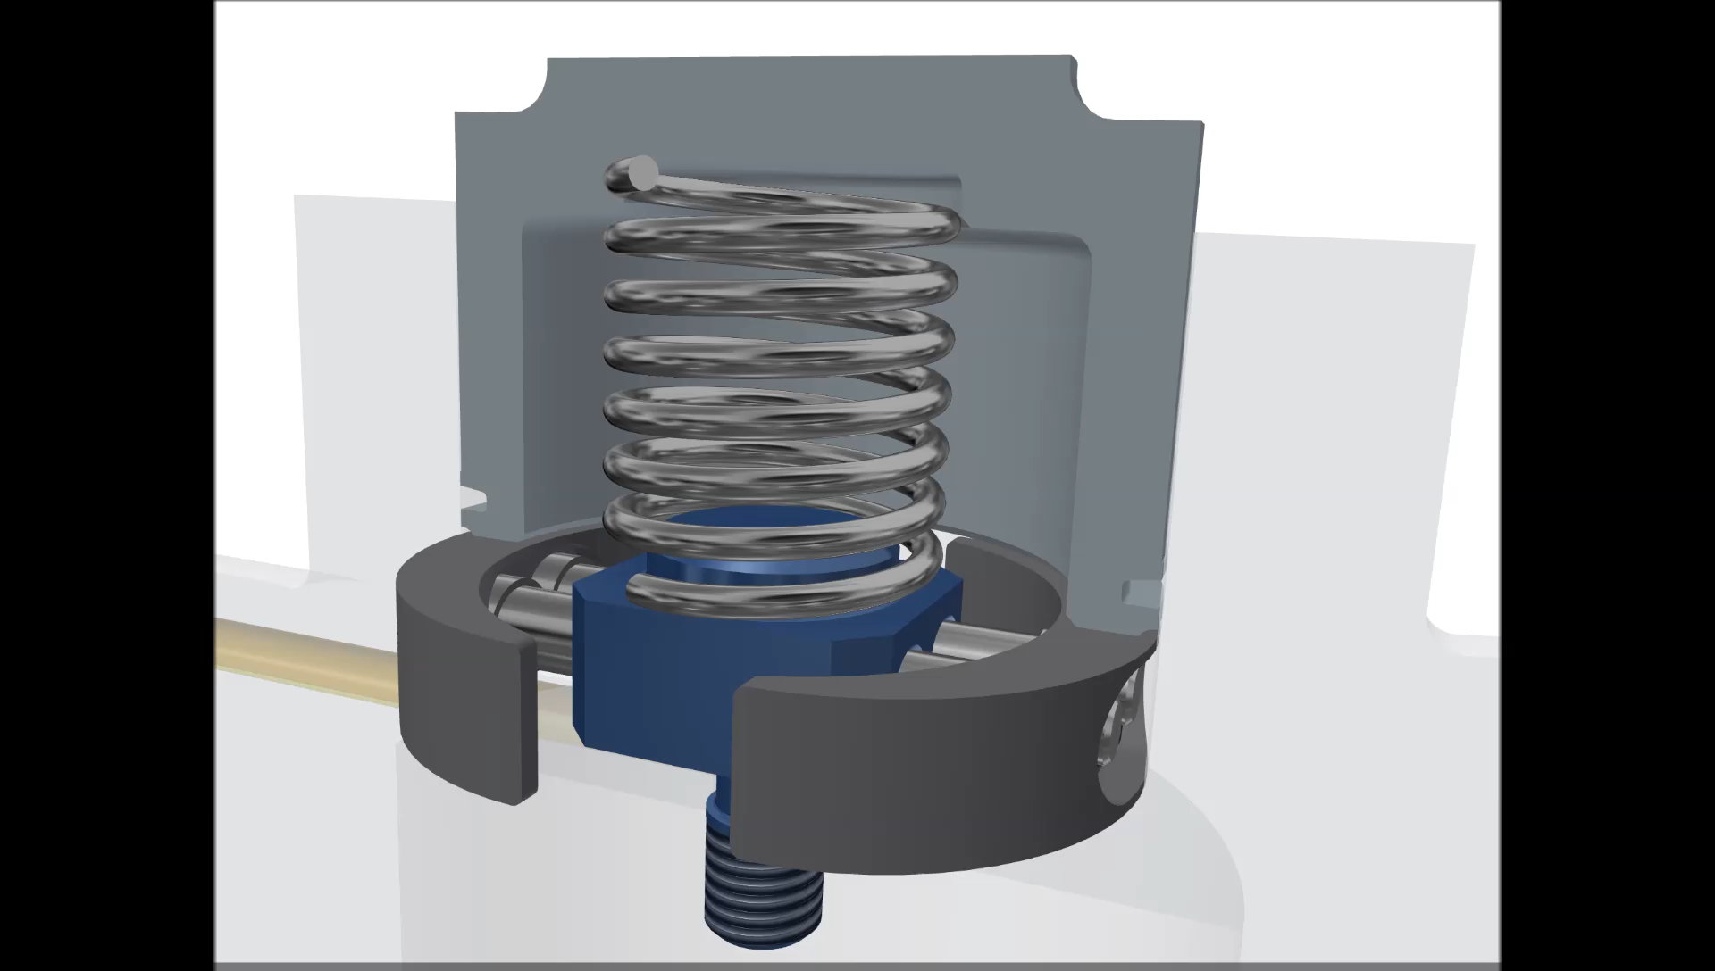
Design: Mechanical Stop Mechanism

Slide 8
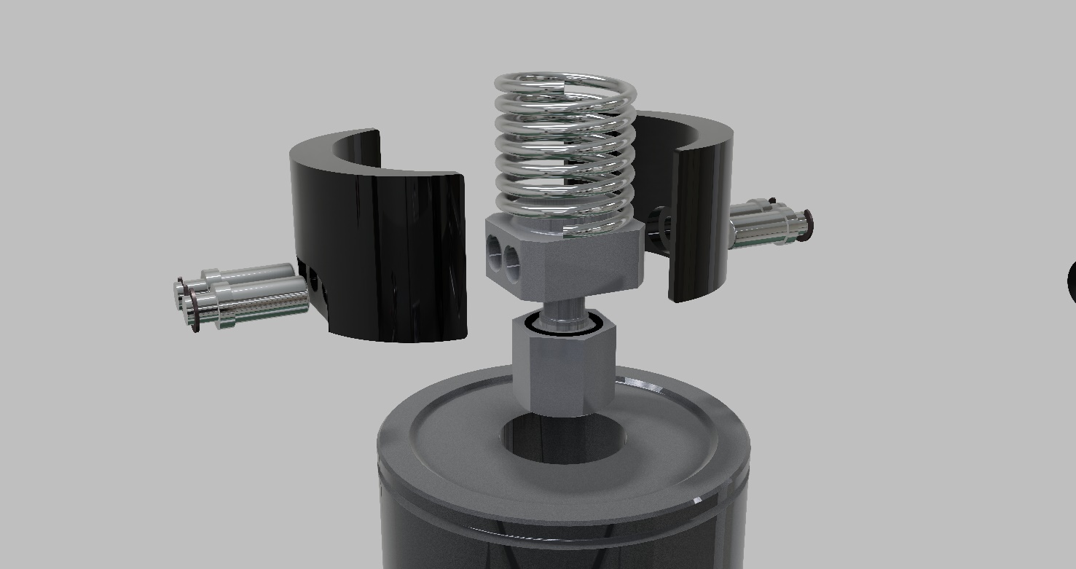
Design: Mechanical Stop Mechanism
Stop Plates (2)
Bias Spring
Pistons (4)
E-clips (4)
Centre Spigot
O-rings (2)
Retaining Nut

Slide 9
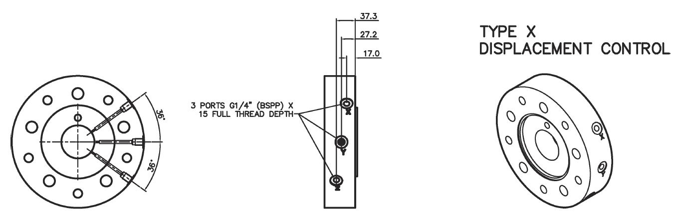
Design: C-Spacer
5-cylinder (HMF100, HMF200)
Notes:
Manual valve design project stopped, waiting for more market data.

Slide 10
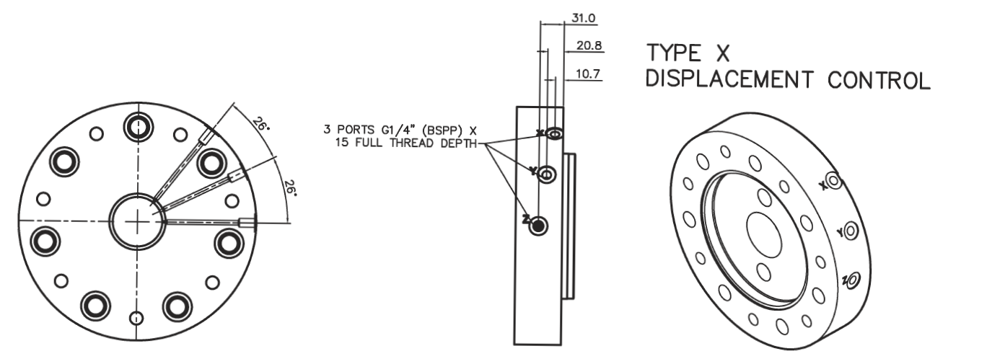
Design: C-Spacer
7-cylinder (HMF270, HMF325)

Slide 11
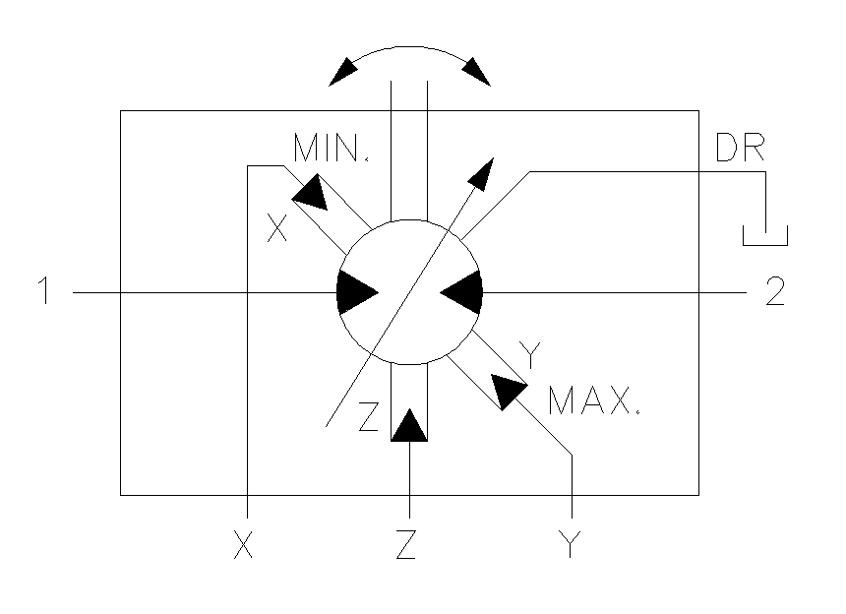
Design: Circuit Symbol

Slide 12
Design: Displacement Sequencing
Displacement change must follow simple rule:
Due to physical constraints
Control system must not allow operator to
contravene this rule
HMF motors must go through high displacement to reach either medium displacement or low displacement

Slide 13

Design: Displacement Sequencing
Sequence | Displacement | Pressure to | Description
1 | High | Y | Mechanism retracted
2 | Low | X | Mechanism retracted
3 | High | Y | Mechanism retracted
4 | Mid | Y→YZ→XZ→X | Mechanism extended, held, clamped
5 | High | Y | Mechanism retracted due to pressure diff.

Slide 14
Design: Displacement Sequencing
t₁
t₂

Slide 15
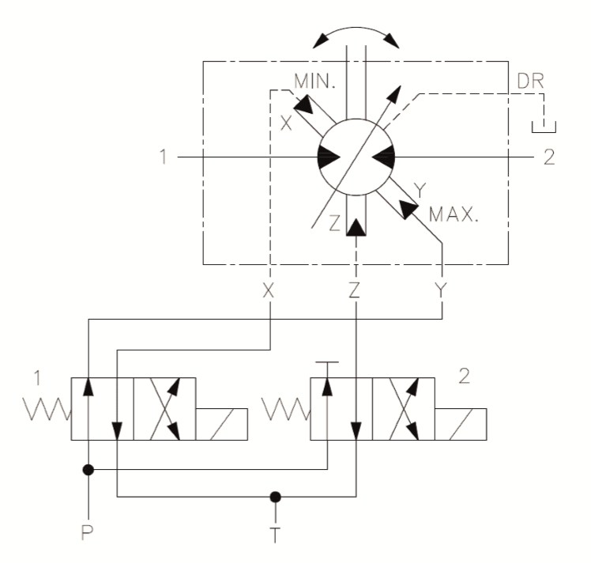
Design: Displacement Sequencing
Displacement | Valve 1 | Valve 2
High | OFF | OFF
Low | ON | OFF
High | OFF | OFF
Medium | OFF ON ON | ON ON (OFF)
High | OFF | OFF

Slide 16
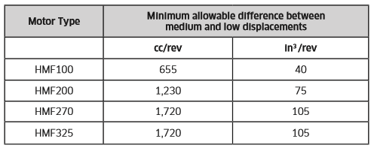
Performance
Max. and min. displacements for high and low displacements are as current HMC motor range
Performance figures as same displacement for HMC
Middle displacement is achieved by adding low displacement to Stop Plate thickness

Slide 17
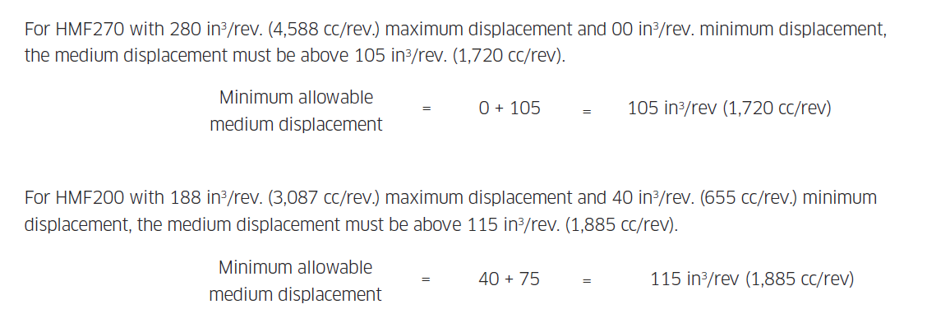
Performance
Examples:

Slide 18
Performance
HMF internal shaft mechanism adds extra leak path
Typical leakage (46 cSt mineral oil @ 50°C):
  @200 bar pilot pressure, HMF200 motor in high displacement mode, extra leakage < 0.8 l/min*
  @200 bar pilot pressure, HMF100 motor in high displacement mode, extra leakage < 0.5 l/min*
*to be verified on production motors

Slide 19
Special Features (P-suffix)
 | HMF080 | HM(HD)F200 | HM(HD)F270 | HM(HD)F325
High Pressure Shaft Seal | ● | ● | ● | ●
Improved Shaft Seal Life | ● | ● | ● | ●
Improved Cavitation Resistance | ● | ● | ● | ●
Anti-pooling Bolt Heads | ● | ● | ● | ●
Increased Starting Torque | ● | ● | ● | ●
Anti-clockwise Rotation | ● | ● | ● | ●
Thermal Shock Resistance | ● | ● | ● | ●
Drain Port Adaptor - 1/2" BSPP | ● | ● | ● | ●
Ф21 mm Mounting Holes | ● | ● | ● | ●
Ф22 mm Mounting Holes | ● | ● | ● | ●
Marine-specification Primer Paint | ● | ● | ● | ●
Increased Power Rating | ● | ● | ● | ●

Slide 20
Installation
Same porting options as HMC series
Same mounting as HMC series
Same shaft options as HMC series
As HMC equivalent +10mm

Slide 21
Model Code
Same as HMC or HPC code except for extra displacement code designation
No S03 or S04 valve housings in catalogue – still available on special request
SM3 added to available valve housings. SM4 coming soon (Q3 2017)
Only X displacement change option at this stage
Special features all still available except CP/CHP valves

Slide 22


