Slide 1
HPC400 Motor
Staffa Training
August 2016

Slide 2
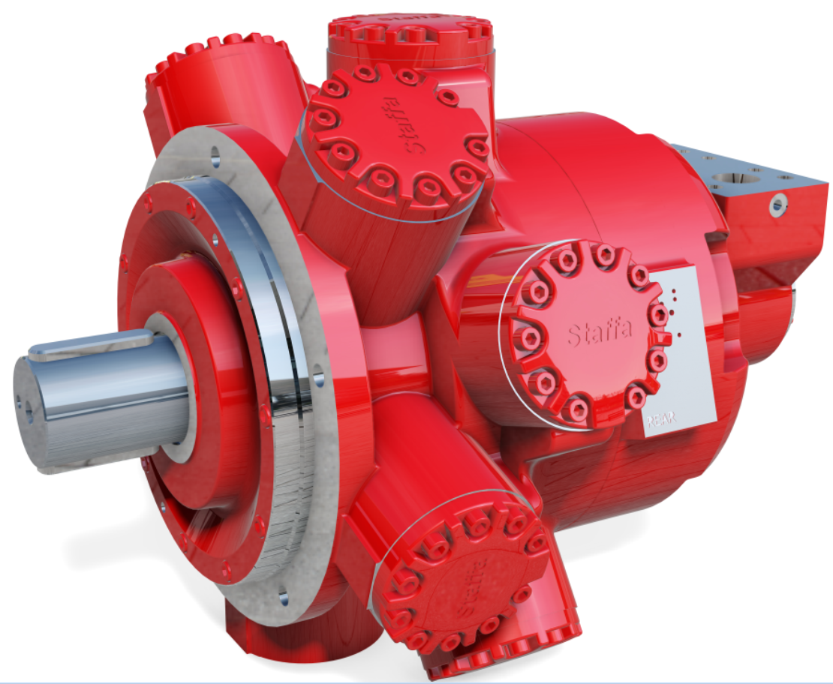
Agenda
HPC400
Description
Market position
Design
R&D Testing
Performance
Installation
Model Code

Slide 3
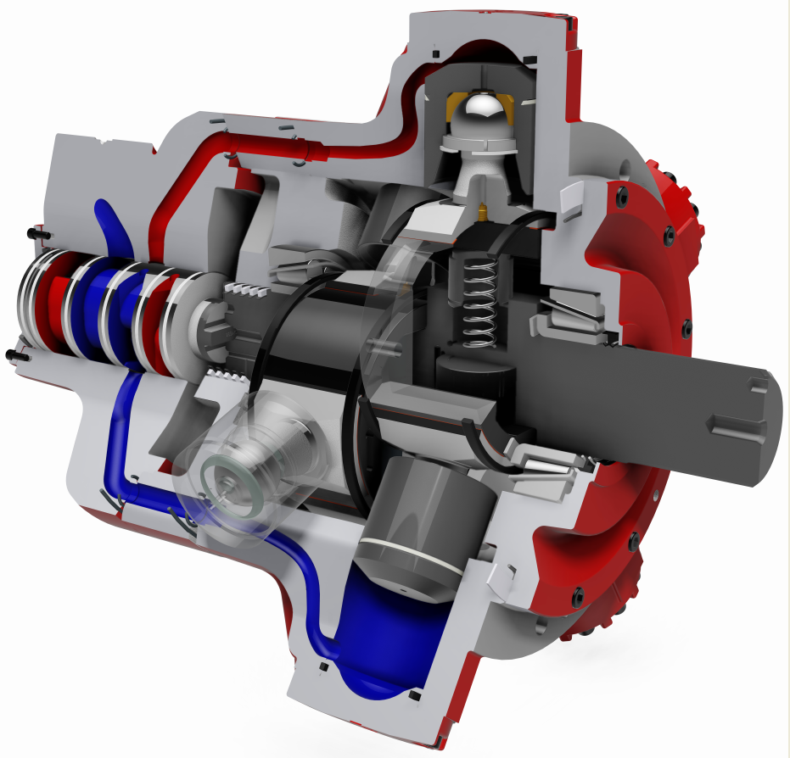
Description
4 displacement modes
Freewheel option available
Rated torque of 25,000 N m
Maximum continuous power of 430 kW
Dynamic displacement change
Based on HPC motor range with all latest developments included
Higher speed rating at full displacement

Slide 4
Market Position
Aimed at marine winch market
Increased power density
Increased flexibility with 4 displacement modes
Reduction of system complexity

Slide 5
Design

Slide 6
Design

Slide 7
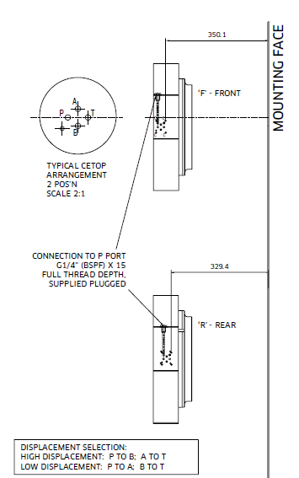
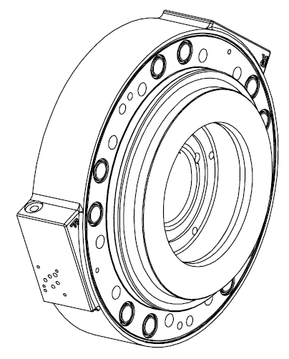
Design: C-Spacer

Slide 8
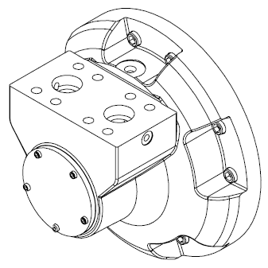
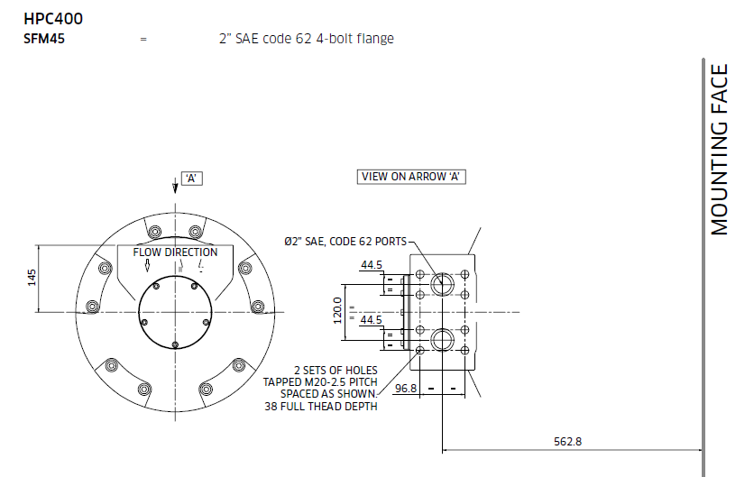
Design: Valve Housing

Slide 9
Design: Seal Technology
Shaft rings: new PEEK material with stainless steel spring backing rings
Improved PV rating
Improved leak rate
Displacement piston seals: new step-section rings
Improved leak rate

Slide 10
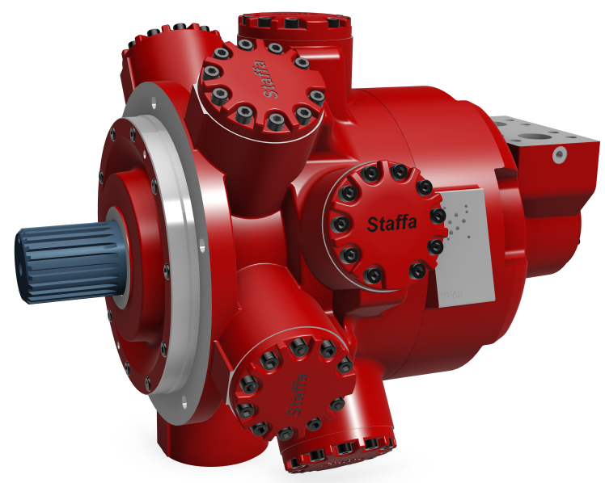
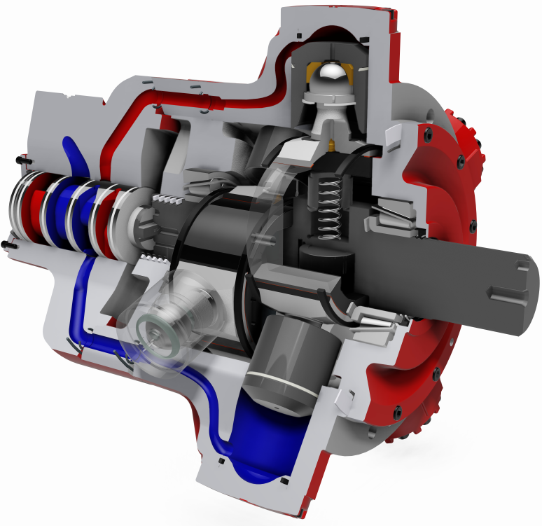
Design: Shaft
Double bank, each bank with high and low displacement
2 shaft options:
Each bank with displacement range 5 in³/rev to 200 in³/rev
Each bank with displacement range 0 in³/rev to 195 in³/rev

Slide 11
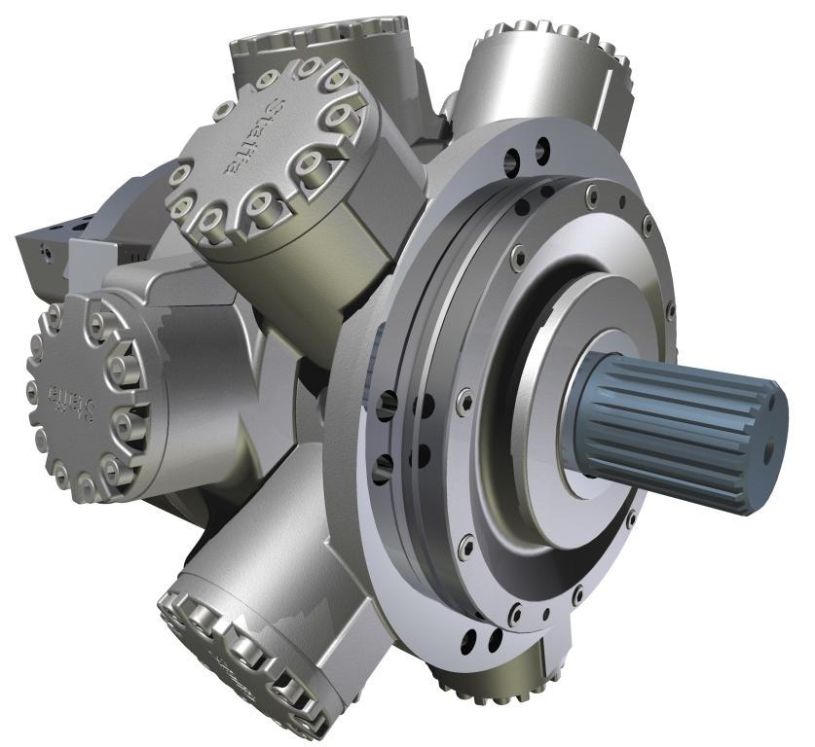
Design: Motorcase
Standard motorcase – 10 bolt holes, Φ22mm
Different to B400 due to target market where acquiring 12.9 grade bolts may not be feasible
Where 12.9 grade bolts can be used, only 5 are required

Slide 12
R&D Testing
2 million-cycle full power testing
Power testing with one drum in freewheel (zero-stroke)
Fatigue and burst testing for all new castings
Seal performance testing

Slide 13
Performance
Significant gains compared to HPC range
Continuous power rating improved
Continuous speed rating improved
Displacements available – 10 in³/rev increments as standard. Others can be made as special parts
Datasheet performance figures limited at present – any figures not given available on request from Staffa Engineering Dept.

Slide 14
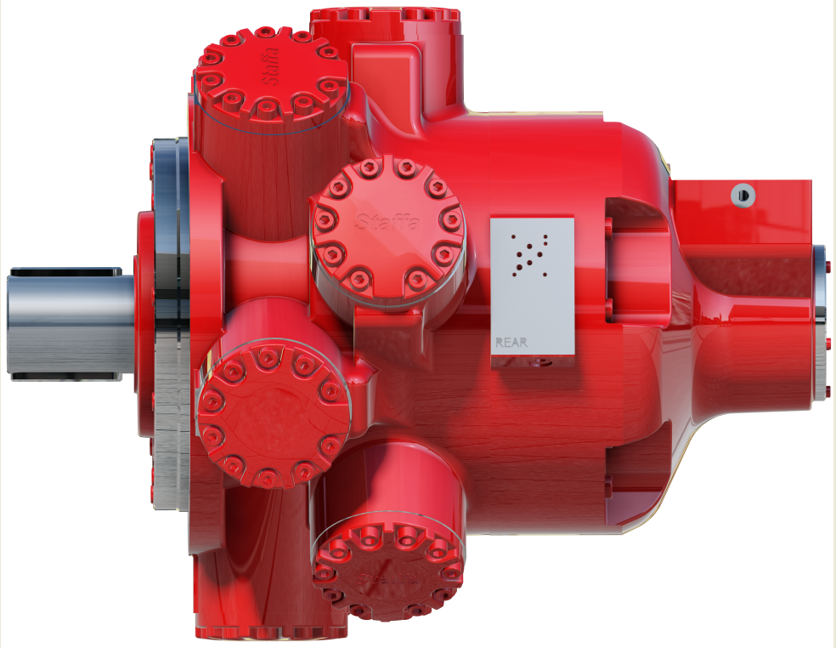
Installation
CETOP3 displacement change only – no X-type
No vertical-up option at launch
Shaft seals: standard and high pressure
5 case drain holes
SFM45 valving only
C-spacer orientation at 2 o’clock and 10 o’clock as standard

Slide 15
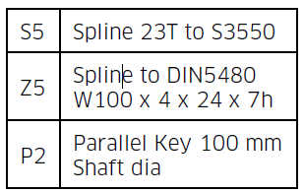
Installation
Displacement options: As current HPC motors, 10 cubic inch increments on each drum
Shaft options:
3D CAD models available on website

Slide 16
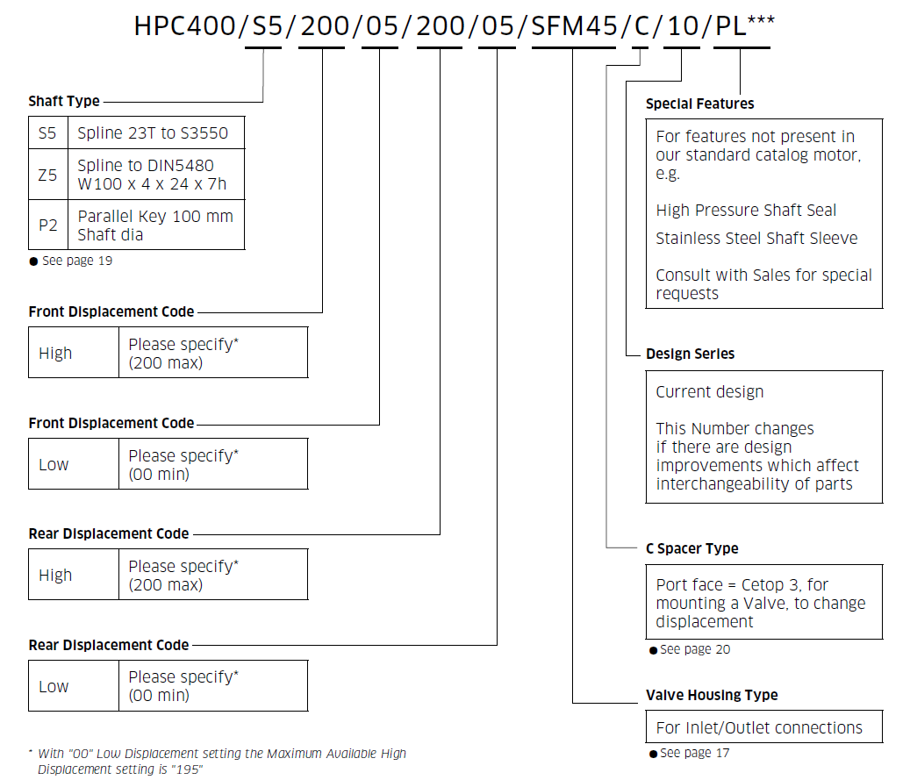
Model Code

